Slide 1
SOCIAL ENGINEERING
Unit-1

Slide 2

What is society?
a group of individuals involved in persistent social interaction
a large social group sharing the same geographical or social territory, typically subject to the same political authority and dominant cultural expectations.
Career Development Centre
SRMIST – kattankulathur

Slide 3
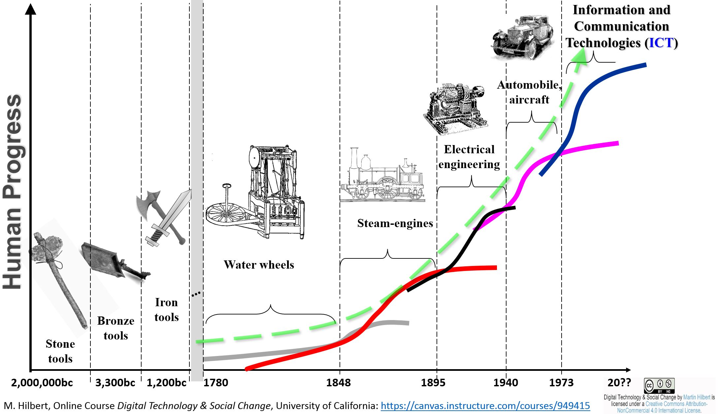
Evolution of society
Career Development Centre
SRMIST – kattankulathur

Slide 4
What is Social Engineering?
to influence attitude and social behavior on a large scale, by government, media or private groups in order to produce desired characteristics in a target population.
a deterministic phenomenon where the intentions and goals of the architects of the new social construct are realized.
triggers planned social change and social development
use of centralized planning to manage social change and regulate the future development and behaviour of a society.
Career Development Centre
SRMIST – kattankulathur

Slide 5
Types of Social Engineering
Karl Popper - main advocate of social engineering
Democratic SE (Piecemeal SE)
Utopian SE
Large-scale SE
Small-scale SE
Impact of social engineering is always proportional to the method adopted.
Career Development Centre
SRMIST – kattankulathur

Slide 6
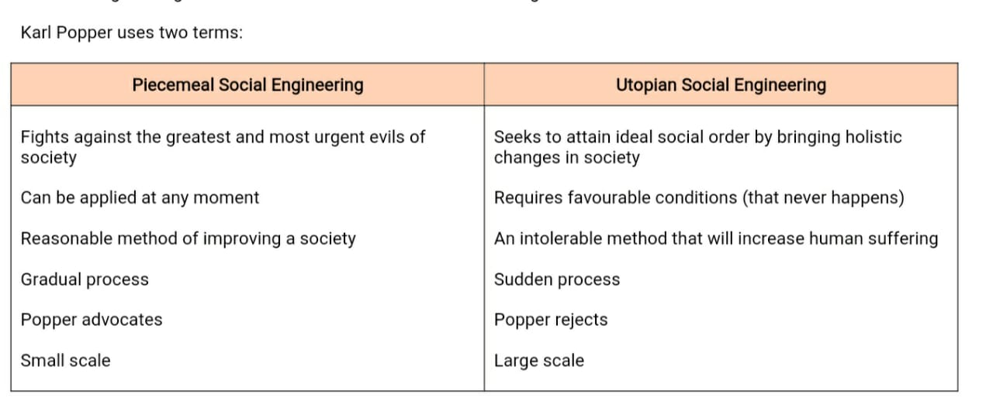
Difference between Piecemeal & Utopian
Career Development Centre
SRMIST – kattankulathur

Slide 7
Social and Emotional Learning
Three interrelated competencies of SEL:
Positive personal and cultural identity (PPCI)
Awareness, understanding and appreciation of all the facets that contribute to a healthy sense of oneself.
Personal awareness and responsibility
The skills, strategies, and dispositions that help us to stay healthy and active, set goals, monitor progress, regulate emotions, respect our own rights and the rights of others, manage stress, and persevere in difficult situations.
Social responsibility
The ability to consider the interdependence of people with each other and the natural environment and to contribute positively to one’s family, community, society and the environment.
Career Development Centre
SRMIST – kattankulathur

Slide 8
Personal Awareness
It results in demonstration of self-respect and expression of personal well-being.
It includes personal efficacy and self-advocacy.
It develops the ability
to understand and take responsibility for our actions, including our learning
to make constructive and ethical decisions about our personal and social behaviour
to recognize and accept consequences, understanding how our actions affect our own well-being and that of others
Career Development Centre
SRMIST – kattankulathur

Slide 9
Types of Responsibilities
Personal responsibility
the idea that human beings choose, instigate, or otherwise cause their own actions
Social responsibility
an ethical framework and suggests that an entity, be it an organization or individual, has an obligation to act for the benefit of society at large
Moral responsibility
Legal responsibility
Career Development Centre
SRMIST – kattankulathur

Slide 10
Personal responsibilities
Responsibility towards Yourself
Responsibility towards Your Family
Responsibility towards Work
Responsibility towards Country
Responsibility towards Humanity
Career Development Centre
SRMIST – kattankulathur

Slide 11
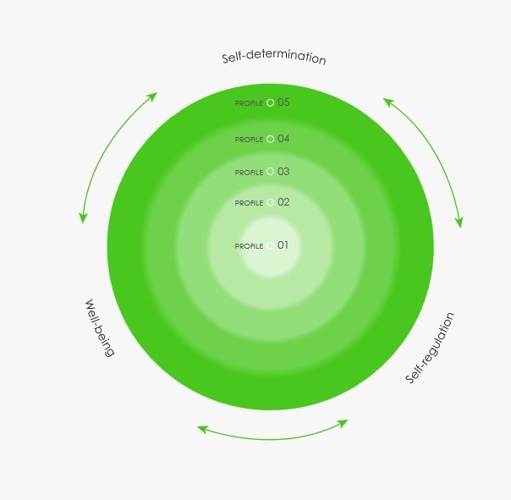
Three facets of Personal Awareness
Self determination
Self regulation
Well being
Career Development Centre
SRMIST – kattankulathur

Slide 12
Thank you

